Slide 1
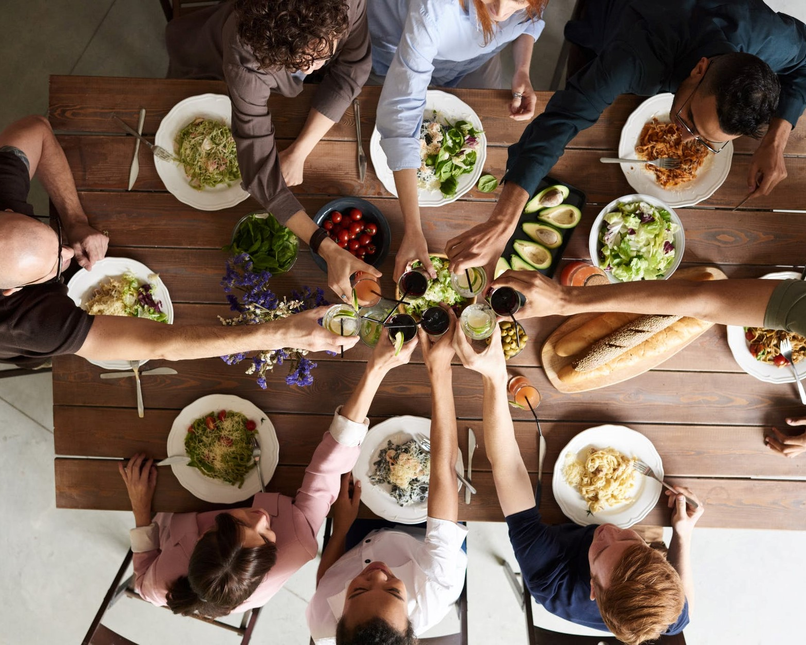

PRINCIPLE
How to win friends & influence people?
AUTHOUR
DALE CARNEGIE

Slide 2
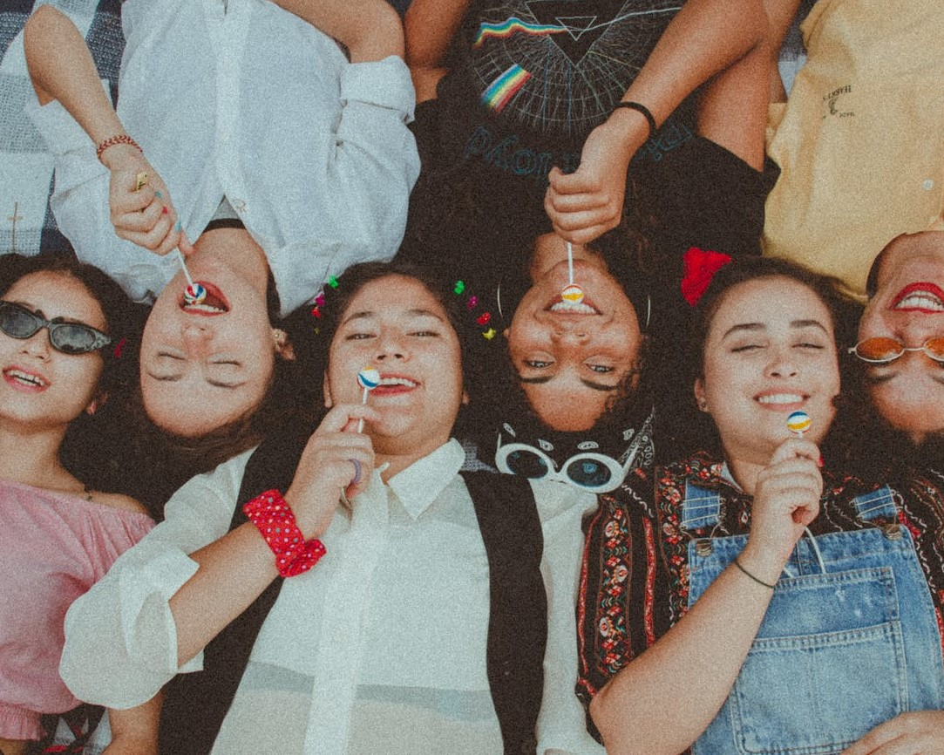
Do not criticise, condemn or complain.
Give honest and sincere appreciation.

Slide 3
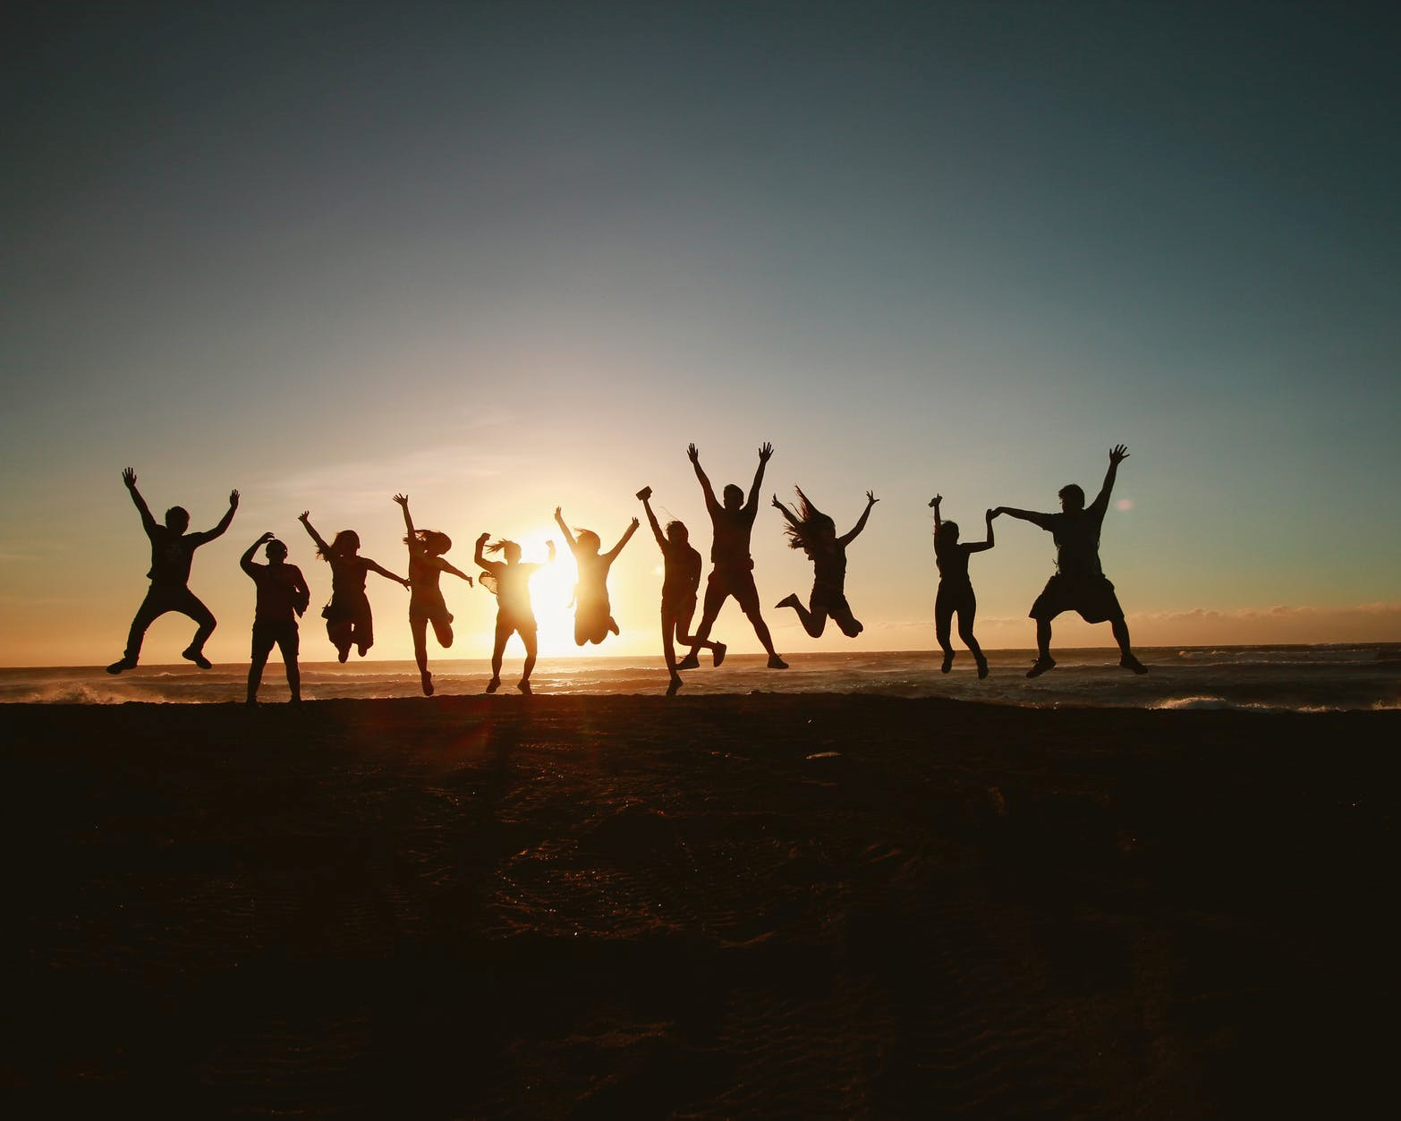
Arouse in the other person an eager want.
Become genuinely interested in other people.

Slide 4

Smile
Remember that a person’s name is to that person the sweetest and most important sound in any language.
Be a good listener. Encourage others to talk about themselves.

Slide 5

Talk in terms of the other person’s interests.
Make the other person feel important – and do it sincerely.
The only way to get the best of an argument is to avoid it.

Slide 6

Show respect for the other person’s opinions. Never say, ‘You’re wrong.’
If you are wrong, admit it quickly and emphatically.
Begin in a friendly way.

Slide 7
Get the other person saying ‘yes, yes’ immediately.
Let the other person do a great deal of the talking.
Let the other person feel that the idea is his or hers.

Slide 8
Try honestly to see things from the other person’s point of view.
Appeal to the nobler motives.
Dramatise your ideas.
Throw down a challenge.

Slide 9
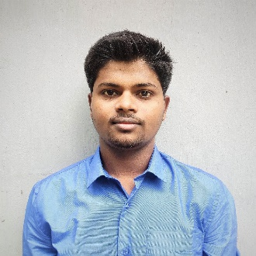
ABOUT ME
Rakesh Vishwakarma
rakesh.tu16@gmail.com

